Slide 1
Do you recognize this man?

Slide 2
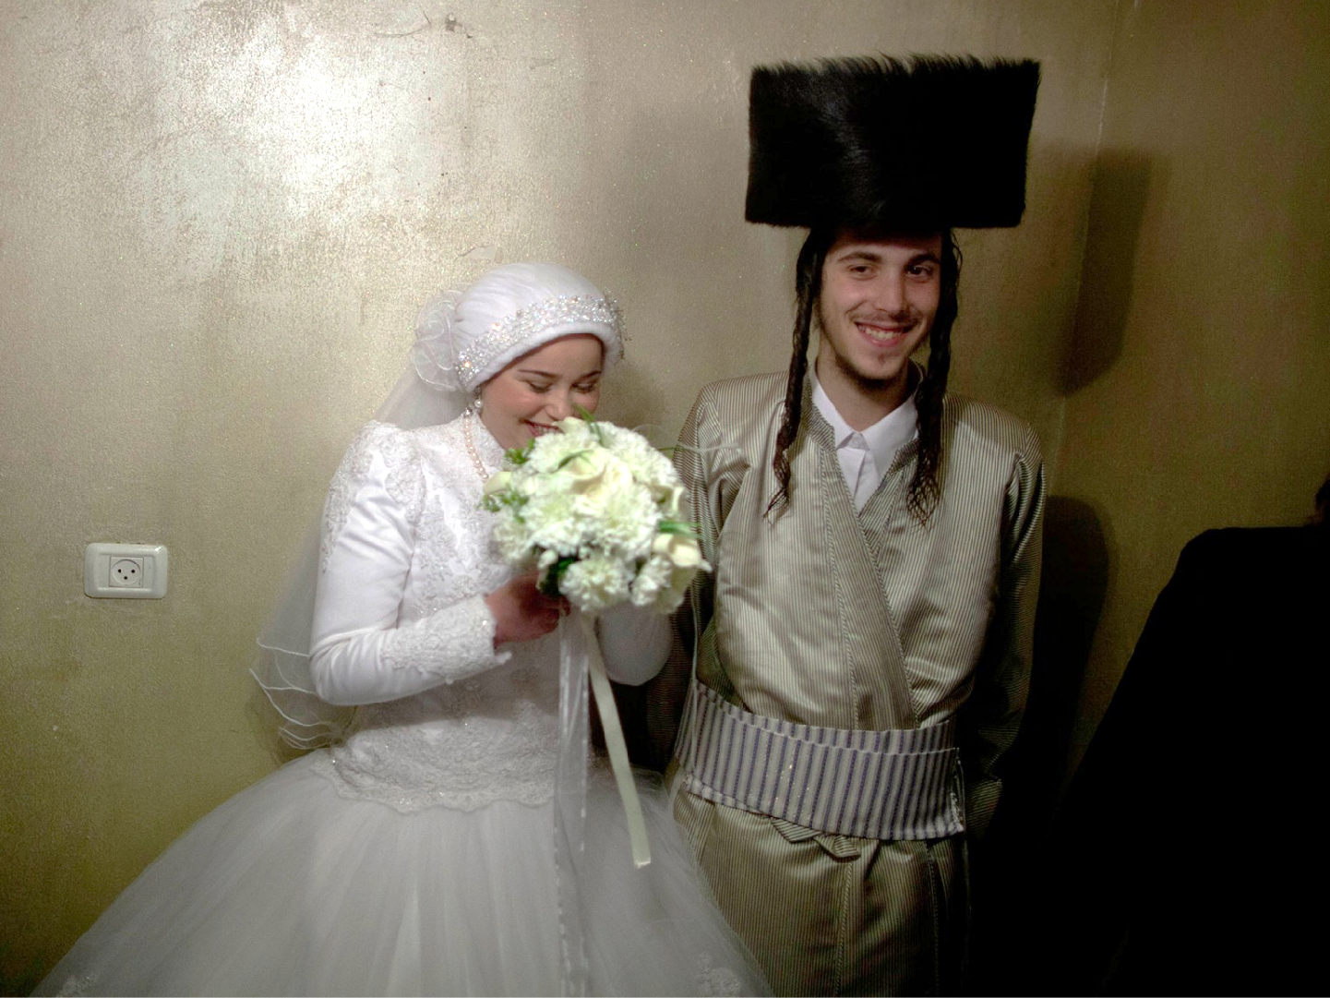
Notes:
Do you recognize what their religion is?

Slide 3
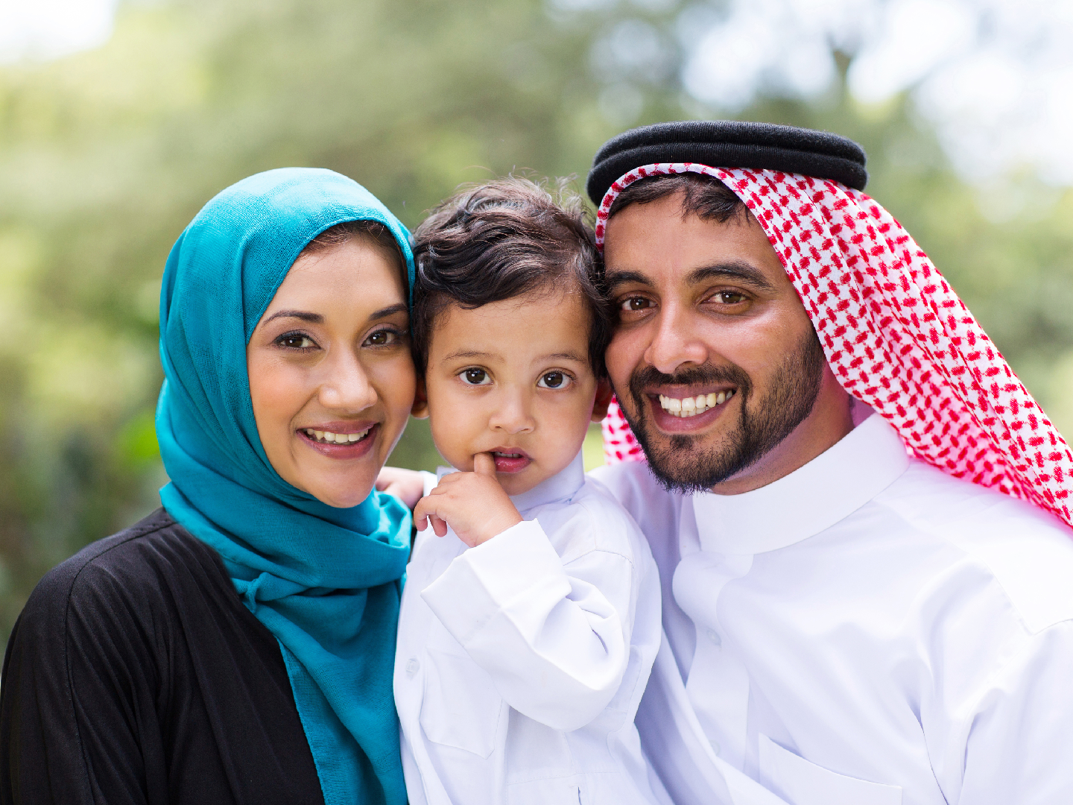
Notes:
Do you recognize what their religion is?

Slide 4
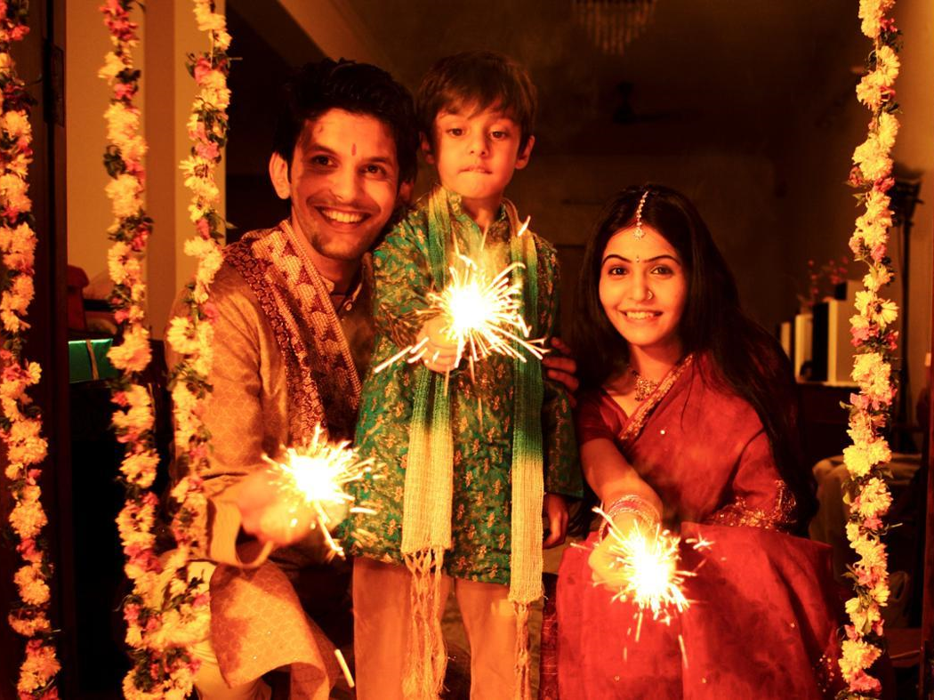
Notes:
Do you recognize what their religion is?

Slide 5
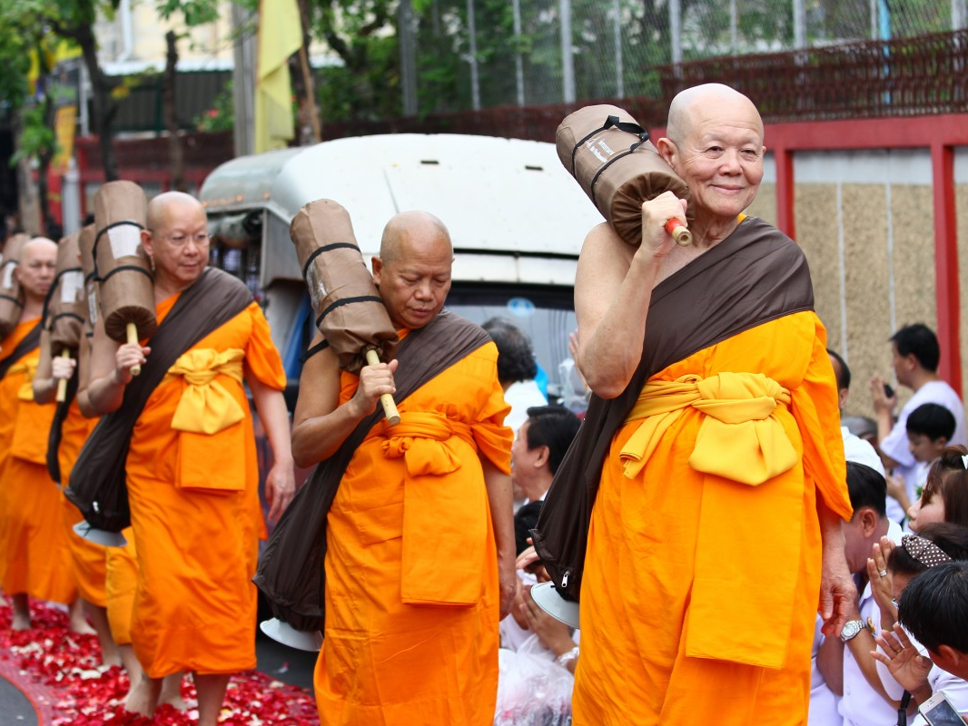
Notes:
Do you recognize what their religion is?

Slide 6
But how do you recognize a follower of Jesus?

Slide 7
But how do you recognize a follower of Jesus?

Slide 9
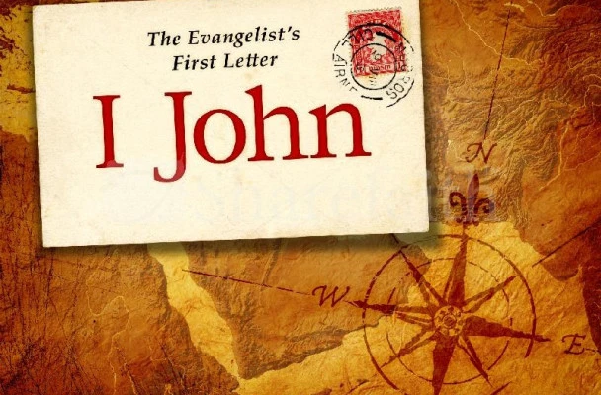
3:13-24
How do you recognize a follower of Jesus?

Slide 10
13 Do not marvel, my brethren, if the world hates you. 14 We know that we have passed from death to life, because we love the brethren. He who does not love his brother abides in death. 15 Whoever hates his brother is a murderer, and you know that no murderer has eternal life abiding in him.

Slide 11
16 By this we know love, because He laid down His life for us. And we also ought to lay down our lives for the brethren. 17 But whoever has this world’s goods, and sees his brother in need, and shuts up his heart from him, how does the love of God abide in him? 18 My little children, let us not love in word or in tongue, but in deed and in truth.

Slide 12
19 And by this we know that we are of the truth, and shall assure our hearts before Him. 20 For if our heart condemns us, God is greater than our heart, and knows all things. 21 Beloved, if our heart does not condemn us, we have confidence toward God. 22 And whatever we ask we receive from Him, because we keep His commandments and do those things that are pleasing in His sight.

Slide 13
23 And this is His commandment: that we should believe on the name of His Son Jesus Christ and love one another, as He gave us commandment. 24 Now he who keeps His commandments abides in Him, and He in him. And by this we know that He abides in us, by the Spirit whom He has given us.

Slide 14
3:13-24
How do you recognize a follower of Jesus?
Notes:
Consider how easy it is to tell the religion of many people in the world by their dress or actions. One religion’s members shave their heads, play musical instruments, and chant and sing in public. The faithful of another religion stop and kneel for prayers, wherever they are, five times a day. Another religion’s orthodox members wear black coats and hats, white shirts, and have long, curly locks of hair or beards. What about Christians? Can you look at a crowd in a mall or an airport and tell who is a born-again follower of Jesus? How can people recognize us as followers of Jesus? How do you recognize a follower of Jesus?

Slide 15
13 Do not marvel, my brethren, if the world hates you. 14 We know that we have passed from death to life, because we love the brethren. He who does not love his brother abides in death. 15 Whoever hates his brother is a murderer, and you know that no murderer has eternal life abiding in him.

Slide 16
13 Do not marvel, my brethren, if the world hates you. 14 We know that we have passed from death to life, because we love the brethren. He who does not love his brother abides in death. 15 Whoever hates his brother is a murderer, and you know that no murderer has eternal life abiding in him.

Slide 17
13 Do not marvel, my brethren, if the world hates you. 14 We know that we have passed from death to life, because we love the brethren. He who does not love his brother abides in death. 15 Whoever hates his brother is a murderer, and you know that no murderer has eternal life abiding in him.
Notes:
Thus far, we have been called to a life of sinlessness. We have also been called to a life of love. Both calls are absolute! And frankly, both calls seem impossible! We know we can’t flee sin completely and we know we can’t love fully. So, what is John trying to say? Why is he calling us to what is seemingly impossible?
The answer is, of course, that what John is calling us to is the GOAL toward which we must move in our lives as followers of Jesus. John knows that no one will reach this goal this side of heaven. John knows that in our fallen state, a sinless life in impossible. And with that, one of the areas in which we fail constantly is in our relationships. We ought to be perfect and love perfectly, but John knows, and we know that we won’t and we can’t. And so here is the tension of the Christian life – the tension between what is and what should be. The tension between death and life. The tension between sin and perfection. The tension between hate and love. A life without love, is easily given over to hatred. The tension between self-sacrifice and self-centeredness. The tension between present imperfection and future perfection. With these tensions, how can we reach that GOAL while still on this earth?

Slide 18
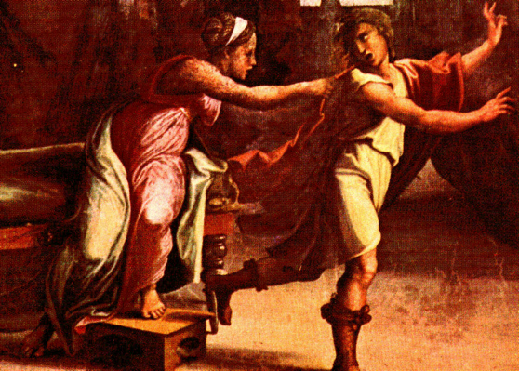
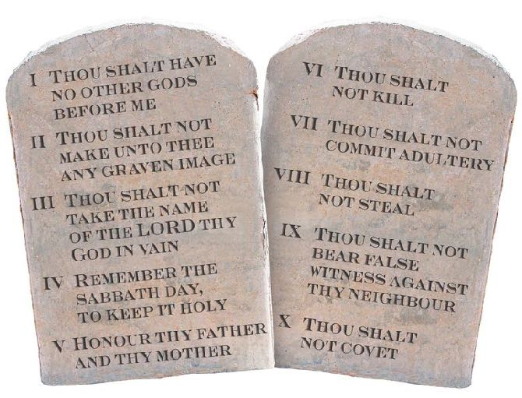
Love and Sinlessness
“hamartia” – missing the mark, missing the goal.
Notes:
In verses 13-15, John tries to explain for us the connection between love and sinlessness (perfection). We can understand this better by going back to verse 12 and what happened between Cain and Abel. We can go back to the root meaning of the “sin”. In Hebrew, the word is “khata”, and in Greek, it is “hamartia”. It means to “miss the mark” or “miss the goal”. But what is the GOAL? What is the mark to aim for? In the OT, God gave the Israelites the Ten Commandments. The first four tell us how we are to love God. The final six tell us how we are to love others. Thus, sin – missing the mark, or failing, is failing to LOVE GOD and LOVE OTHERS. Or in other words, failing to love God is failing to love others. And vice versa, failing to love and respect someone made in God’s image is failing to love God. Failing to honor people is failing to God. Sin against people is sin against God. When we continue to fail to love, we continue to sin. In Genesis 39, we find that when Joseph was tempted by Potiphar’s wife, he fled and he said in verse 9, “How could I sin against God?”

Slide 19
Love and Sinlessness
“hamartia” – missing the mark, missing the goal.
Loving God and others – Selflessness vs. Selfishness
The world will hate us for choosing to love.
Notes:
John is essentially calling us to love God and others – thus is the tension between self sacrifice and self-centeredness, or selflessness vs. selfishness. In order to move towards sinlessness, we must LOVE. The way towards sinlessness is to love and be selfless. To pursue sinlessness is to pursue love. Want to figure out a way to be sinless? Here’s how. Be selfless. Love others. To try to live sinlessly, is to love perfectly. To love perfectly, is to live sinlessly. This is so counterintuitive. This is so counterculture. Verse 13 tells us, do not be surprised, do not marvel, if the world hates you.

